Slide 1
Chapter 12: File System Implementation

Slide 2
Chapter 12: File System Implementation
File-System Structure
File-System Implementation
Directory Implementation
Allocation Methods
Free-Space Management
Efficiency and Performance
Recovery
NFS
Example: WAFL File System

Slide 3
Objectives
To describe the details of implementing local file systems and directory structures
To describe the implementation of remote file systems
To discuss block allocation and free-block algorithms and trade-offs

Slide 4
File-System Structure
File structure
Logical storage unit
Collection of related information
File system resides on secondary storage (disks)
Provided user interface to storage, mapping logical to physical
Provides efficient and convenient access to disk by allowing data to be stored, located retrieved easily
Disk provides in-place rewrite and random access
I/O transfers performed in blocks of sectors (usually 512 bytes)
File control block – storage structure consisting of information about a file
Device driver controls the physical device
File system organized into layers

Slide 5
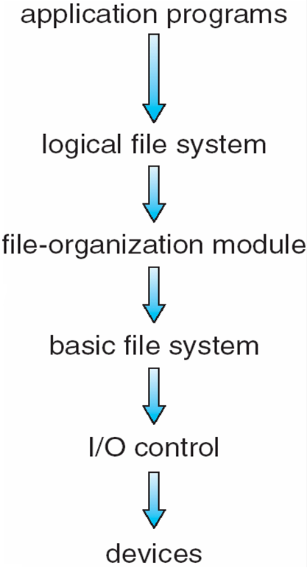
Layered File System

Slide 6
File System Layers
Device drivers manage I/O devices at the I/O control layer
Given commands like “read drive1, cylinder 72, track 2, sector 10, into memory location 1060” outputs low-level hardware specific commands to hardware controller
Basic file system given command like “retrieve block 123” translates to device driver
Also manages memory buffers and caches (allocation, freeing, replacement)
Buffers hold data in transit
Caches hold frequently used data
File organization module understands files, logical address, and physical blocks
Translates logical block # to physical block #
Manages free space, disk allocation

Slide 7
File System Layers (Cont.)
Logical file system manages metadata information
Translates file name into file number, file handle, location by maintaining file control blocks (inodes in UNIX)
Directory management
Protection
Layering useful for reducing complexity and redundancy, but adds overhead and can decrease performanceTranslates file name into file number, file handle, location by maintaining file control blocks (inodes in UNIX)
Logical layers can be implemented by any coding method according to OS designer

Slide 8
File System Layers (Cont.)
Many file systems, sometimes many within an operating system
Each with its own format (CD-ROM is ISO 9660; Unix has UFS, FFS; Windows has FAT, FAT32, NTFS as well as floppy, CD, DVD Blu-ray, Linux has more than 40 types, with extended file system ext2 and ext3 leading; plus distributed file systems, etc.)
New ones still arriving – ZFS, GoogleFS, Oracle ASM, FUSE

Slide 9
File-System Implementation
We have system calls at the API level, but how do we implement their functions?
On-disk and in-memory structures
Boot control block contains info needed by system to boot OS from that volume
Needed if volume contains OS, usually first block of volume
Volume control block (superblock, master file table) contains volume details
Total # of blocks, # of free blocks, block size, free block pointers or array
Directory structure organizes the files
Names and inode numbers, master file table

Slide 10
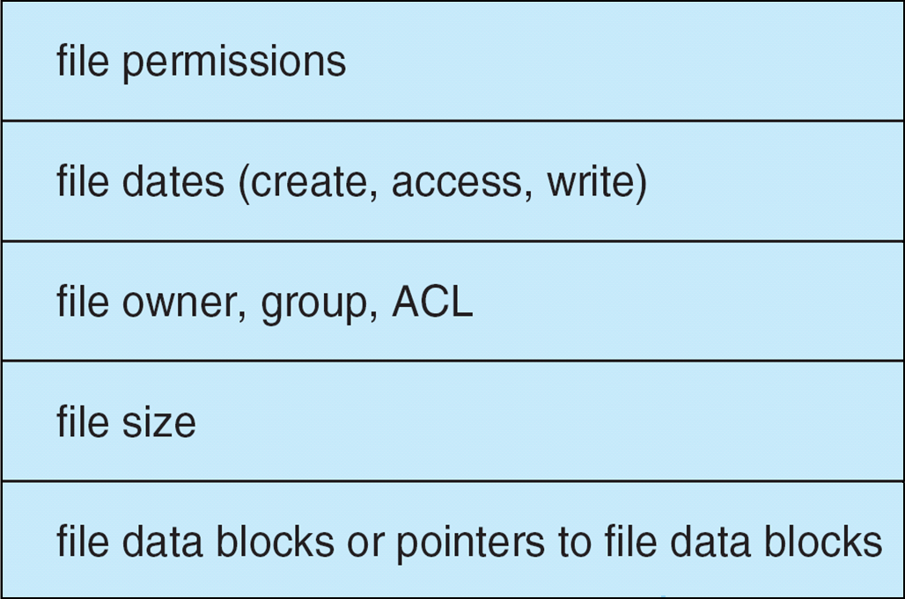
File-System Implementation (Cont.)
Per-file File Control Block (FCB) contains many details about the file
inode number, permissions, size, dates
NFTS stores into in master file table using relational DB structures

Slide 11
In-Memory File System Structures
Mount table storing file system mounts, mount points, file system types
The following figure illustrates the necessary file system structures provided by the operating systems
Figure 12-3(a) refers to opening a file
Figure 12-3(b) refers to reading a file
Plus buffers hold data blocks from secondary storage
Open returns a file handle for subsequent use
Data from read eventually copied to specified user process memory address

Slide 12
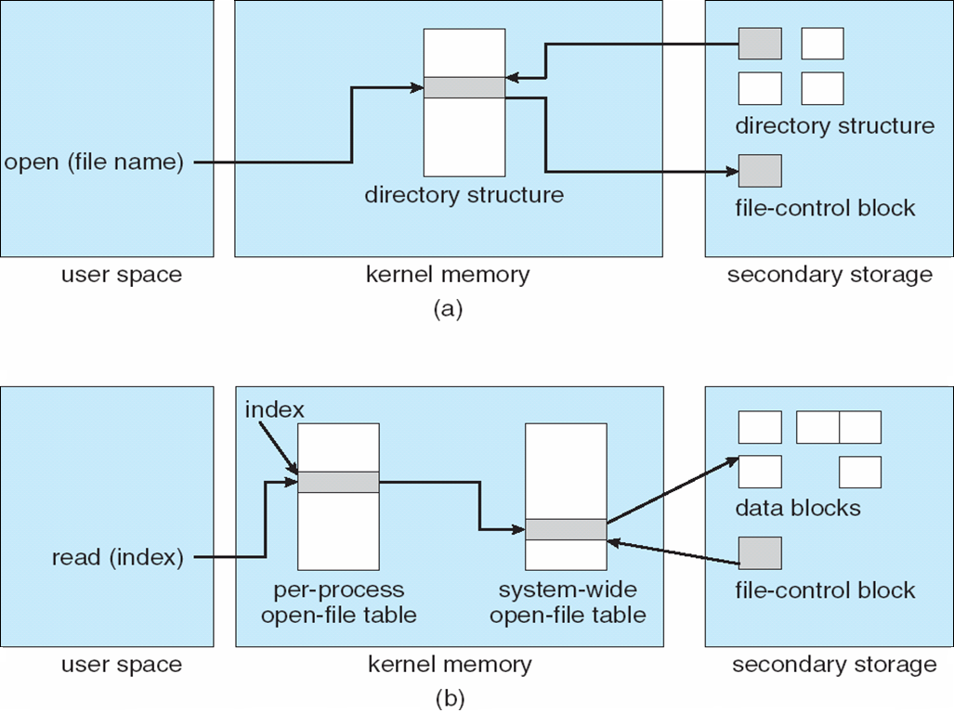
In-Memory File System Structures

Slide 13
Allocation Methods - Contiguous
An allocation method refers to how disk blocks are allocated for files:
Contiguous allocation – each file occupies set of contiguous blocks
Best performance in most cases
Simple – only starting location (block #) and length (number of blocks) are required
Problems include finding space for file, knowing file size, external fragmentation, need for compaction off-line (downtime) or on-line

Slide 14
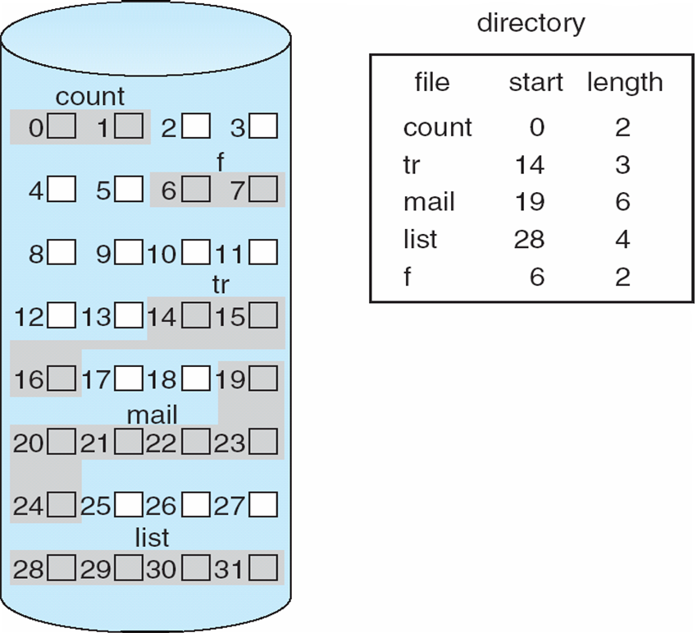
Contiguous Allocation
Mapping from logical to physical
Q
LA/512
R
Block to be accessed = Q + starting address
Displacement into block = R

Slide 15
Extent-Based Systems
Many newer file systems (i.e., Veritas File System) use a modified contiguous allocation scheme
Extent-based file systems allocate disk blocks in extents
An extent is a contiguous block of disks
Extents are allocated for file allocation
A file consists of one or more extents

Slide 16
Allocation Methods - Linked
Linked allocation – each file a linked list of blocks
File ends at nil pointer
No external fragmentation
Each block contains pointer to next block
No compaction, external fragmentation
Free space management system called when new block needed
Improve efficiency by clustering blocks into groups but increases internal fragmentation
Reliability can be a problem
Locating a block can take many I/Os and disk seeks

Slide 17
Allocation Methods – Linked (Cont.)
FAT (File Allocation Table) variation
Beginning of volume has table, indexed by block number
Much like a linked list, but faster on disk and cacheable
New block allocation simple

Slide 18
Linked Allocation
Each file is a linked list of disk blocks: blocks may be scattered anywhere on the disk
block =
pointer
Mapping
Q
LA/511
R
Block to be accessed is the Qth block in the linked chain of blocks representing the file.
Displacement into block = R + 1

Slide 19
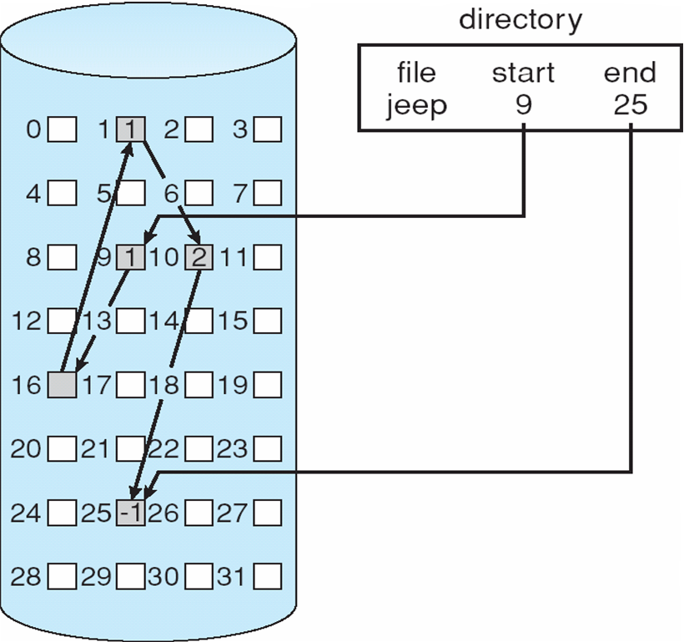
Linked Allocation

Slide 20
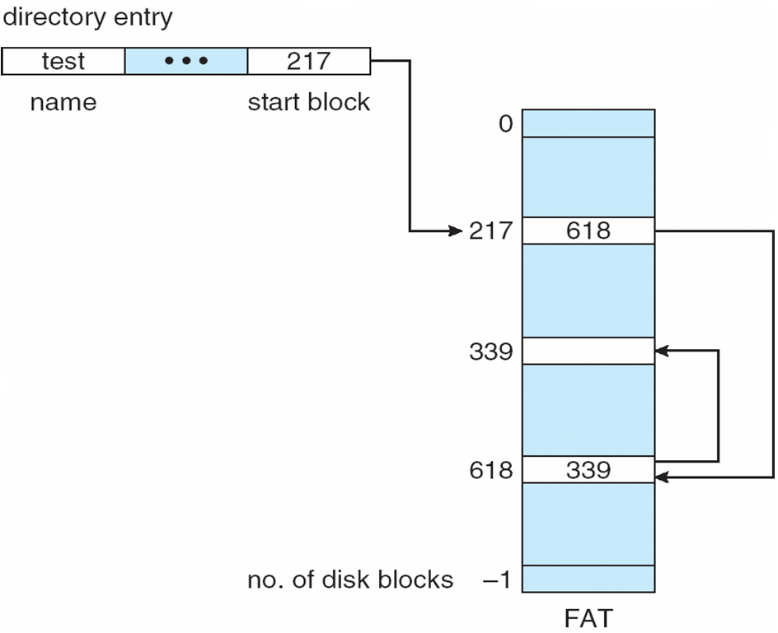
File-Allocation Table

Slide 21
Allocation Methods - Indexed
Indexed allocation
Each file has its own index block(s) of pointers to its data blocks
Logical view

Slide 22
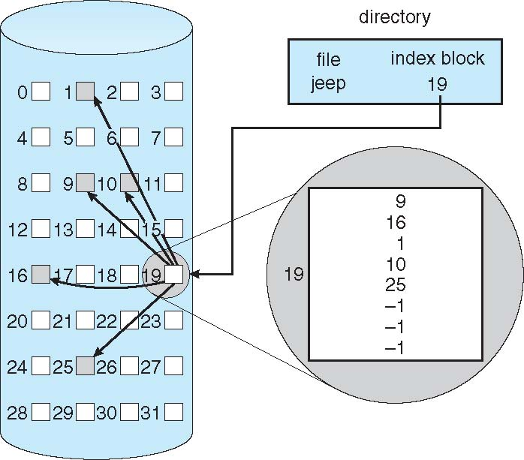
Example of Indexed Allocation

Slide 23
Indexed Allocation (Cont.)
Need index table
Random access
Dynamic access without external fragmentation, but have overhead of index block
Mapping from logical to physical in a file of maximum size of 256K bytes and block size of 512 bytes. We need only 1 block for index table
Q
LA/512
R
Q = displacement into index table
R = displacement into block

Slide 24
Indexed Allocation – Mapping (Cont.)
Mapping from logical to physical in a file of unbounded length (block size of 512 words)
Linked scheme – Link blocks of index table (no limit on size)
Q₁
LA / (512 x 511)
R₁
Q₁ = block of index table
R₁ is used as follows:
Q₂
R₁ / 512
R₂
Q₂ = displacement into block of index table
R₂ displacement into block of file:

Slide 25
Indexed Allocation – Mapping (Cont.)
Two-level index (4K blocks could store 1,024 four-byte pointers in outer index -> 1,048,567 data blocks and file size of up to 4GB)
Q₁
LA / (512 x 512)
R₁
Q₁ = displacement into outer-index
R₁ is used as follows:
Q₂
R₁ / 512
R₂
Q₂ = displacement into block of index table
R₂ displacement into block of file:

Slide 26
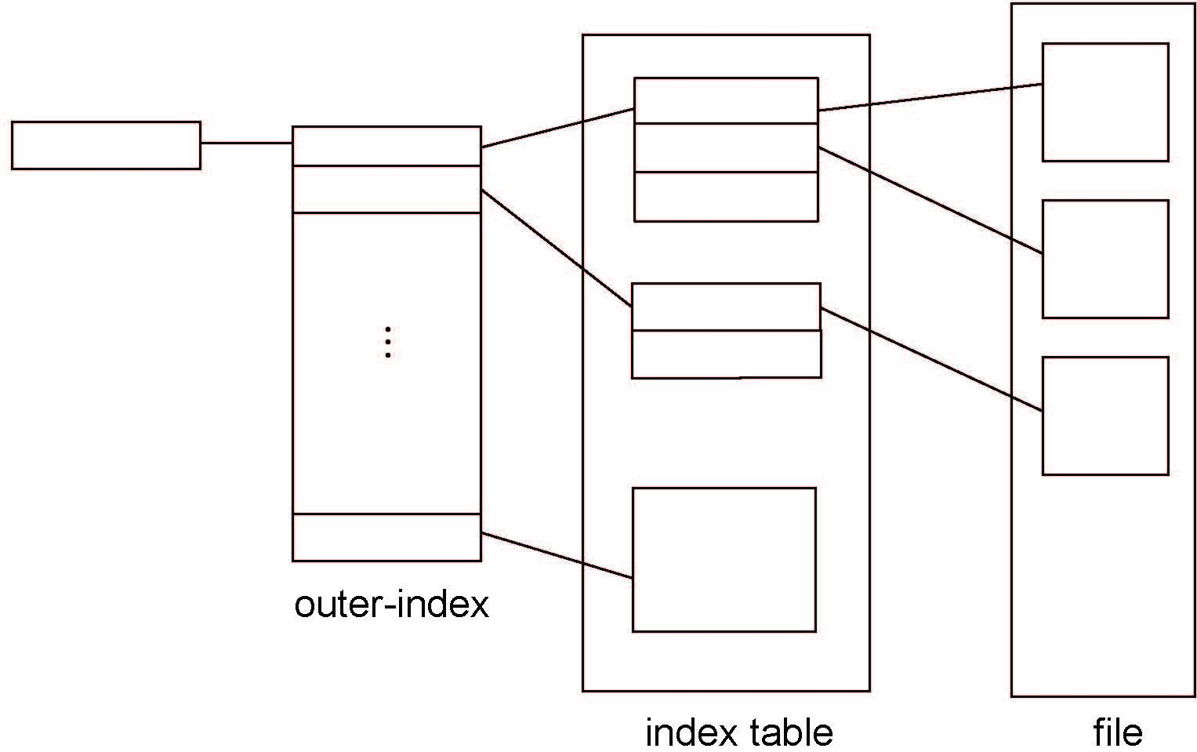
Indexed Allocation – Mapping (Cont.)

Slide 27
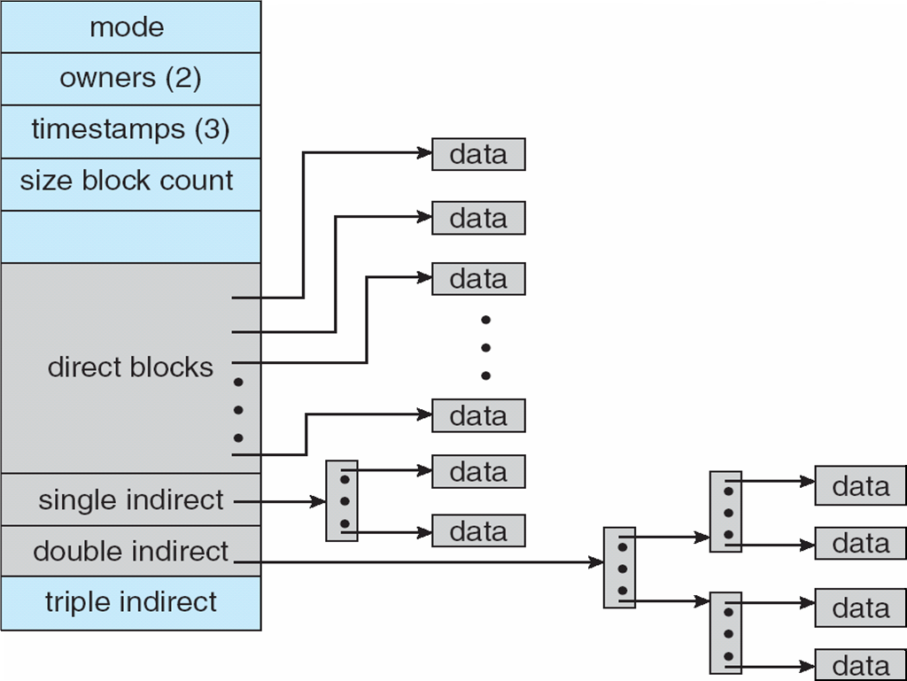
Combined Scheme: UNIX UFS
4K bytes per block, 32-bit addresses
More index blocks than can be addressed with 32-bit file pointer

Slide 28
End of Chapter 12

